Slide 1
Choco Oreo Drink
Jon Lyndel
Janine Arbado
Learnie Grace Reyes
Revi Pureza

Slide 2
objective
Our objective is to raise money so that we can help your neighborhood for relief aid and as many as possible.

Slide 3
data
Annual Fixed Cost | $5,227.20
Variable Costs | $0.30
Price | $0.80
% of Demand | 60%
Break-Even Point 10454.4
Annual Net Profit $2,829
Notes:
The annual fix cost is covered by shop rental and utilities like power, trash and water.
The second data shows about price and percent of demand.
We can compute the break even point with formula break-even point = Fixed Cost / (Price - Variable Costs).
The annual net profit is the total of cups per sold, annual cost and annual revenue.

Slide 4
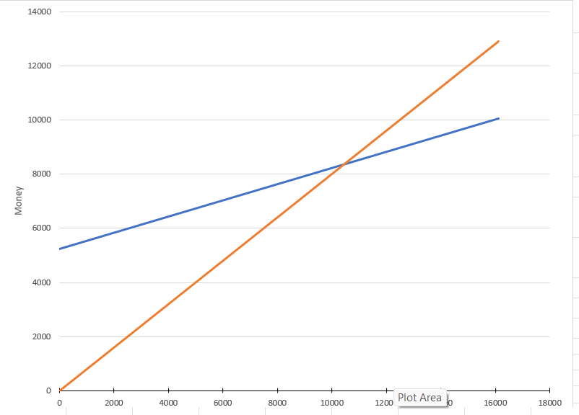
Yearly Cost and Revenue
Notes:
We can see the line graph shows the cost and revenue per year. The blue line represents the annual cost or the fixed and variable while the orange line represents the annual avenue.

Slide 5
Conclusion
We highly appreciate your time Ms. Anna and giving a chance to present this to you.
We are looking forward to work with you soon. Thank you so much

